Slide 1


Can Statistics Detect Fake Data?
Identifying Anomalies and Outliers in Real Datasets Using Benford’s Law and Chi-Square Goodness-of-Fit
FACULTY SUPERVISOR
STUDENT 1
STUDENT 2
Dr. Tharasi Dilleswar
Shaik Sameer
Joshita Chowdary
Slot: F1 SLOT • BMAT202P
Reg. No: 24BDS1154
Reg. No: 24BRS1313

Slide 2


01 Problem Statement
The Numerical Audit Challenge
Real-world datasets regularly contain vast numbers of numerical entries. In such dense environments, identifying manufactured records, manipulations, or unusual reporting habits is virtually impossible through manual inspection alone.
CRITICAL INTERPRETATION PRINCIPLE
Statistical Deviation ≠ Proof of Fraud
A statistically significant deviation from Benford’s Law does not prove fraud, forgery, or malicious manipulation.
The Statistical Framework Solution
Instead, it serves as a rigorous, objective diagnostic flag that highlights unusual structural patterns requiring domain review and contextual investigation.
This project investigates whether automated statistical analysis can systematically flag numerical distributions that diverge from natural expected first-digit frequencies using Benford’s Law as the primary mathematical standard.
Probability and Statistics Project • Review 1
Benford’s Law & Chi-Square Analysis

Slide 3



02 Abstract & Methodology Overview
1. R-Based Data Audit
2. Digit Extraction
3. Goodness-of-Fit Test
Import and clean real-world numerical datasets in R. Remove invalid observations and compute descriptive summary metrics and preliminary graphs.
Extract the leading significant digit (1–9) from every valid numerical record and determine its empirical sample frequency distribution.
Compare observed counts directly against theoretical Benford probabilities using Pearson's Chi-square test to verify statistical significance.
CORE PROJECT DELIVERABLE
Subsets and datasets exhibiting statistically significant departures from Benford's distribution are flagged for further scrutiny, maintaining a strict distinction between empirical statistical evidence and allegations of intentional manipulation.
Probability and Statistics Project • Review 1
Benford’s Law & Chi-Square Analysis

Slide 4




03 Project Flow & Execution Pipeline
STAGE 01
STAGE 02
STAGE 03
STAGE 04
Dataset Selection
Data Preparation
Exploratory Analysis
Digit Extraction
Select real-world numerical data suitable for natural first-digit distribution analysis.
Import into R, inspect variables, filter missing/invalid entries, and format fields.
Calculate summary statistics and construct plots to understand scale and spread.
Extract the leading digit (1–9) and compute observed frequencies across the dataset.
STAGE 05
STAGE 06
STAGE 07
STAGE 08
Expected Distribution
Statistical Testing
Anomaly Flagging
Interpretation
Compute theoretical probabilities for digits 1–9 using the logarithmic Benford model.
Execute Chi-square goodness-of-fit to compare observed and expected counts.
Flag subsets with p-values falling below the significance threshold (p < 0.05).
Formulate statistical conclusions while respecting data generation limitations.
Probability and Statistics Project • Review 1
Benford’s Law & Chi-Square Analysis

Slide 5


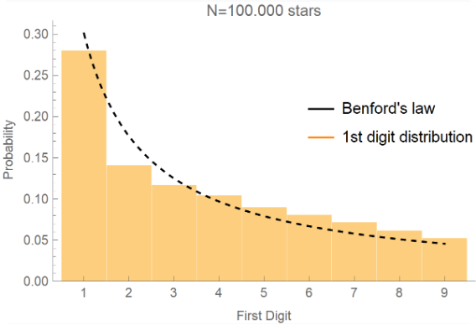

04 Benford’s Law: The Core Concept
Counter-Intuitive First-Digit Decay
In naturally occurring datasets spanning multiple orders of magnitude, the leading digits (1–9) do not appear with equal uniform probability (11.11%).
Instead, smaller digits appear substantially more frequently as the leading numeral than larger digits. Digit 1 leads in ~30.1% of cases, whereas digit 9 leads in only ~4.6%.
MATHEMATICAL DEFINITION
Probability and Statistics Project • Review 1
Benford’s Law & Chi-Square Analysis

Slide 6









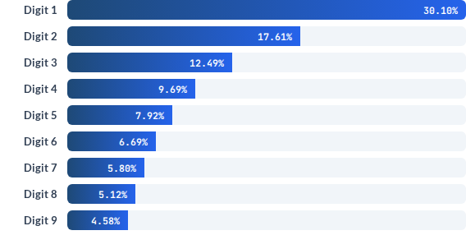


04 Theoretical First-Digit Distribution
1
2
3
4
5
6
7
8
9
30.10%
17.61%
12.49%
9.69%
7.92%
6.69%
5.80%
5.12%
4.58%
Calculating Expected Counts
These values are strictly theoretical parameters. For any dataset of size , the expected frequency is computed as:
BENCHMARK ILLUSTRATION
In a sample of N = 10,000 records, the expected count starting with digit 1 is 10,000 × 0.3010 = 3,010 observations, while digit 9 expects only 458 observations.
Probability and Statistics Project • Review 1
Benford’s Law & Chi-Square Analysis

Slide 7



05 Observed vs Expected Distributions
Digit (d) | Observed Frequency (O_d) | Expected Frequency (E_d)
1 | Extracted from dataset | Calculated via Benford's Law (30.1%)
2 | Extracted from dataset | Calculated via Benford's Law (17.6%)
3 | Extracted from dataset | Calculated via Benford's Law (12.5%)
4 | Extracted from dataset | Calculated via Benford's Law (9.7%)
5 | Extracted from dataset | Calculated via Benford's Law (7.9%)
6 | Extracted from dataset | Calculated via Benford's Law (6.7%)
7 | Extracted from dataset | Calculated via Benford's Law (5.8%)
8 | Extracted from dataset | Calculated via Benford's Law (5.1%)
9 | Extracted from dataset | Calculated via Benford's Law (4.6%)
Two Independent Distributions
A central tenet of our design is the rigorous separation between empirical data and theoretical expectations:
•
Observed Distribution (O_d): Derived strictly from the dataset by extracting the first digit of every valid observation.
•
Expected Distribution (E_d): Determined analytically from the Benford logarithmic function multiplied by total sample size .
THE CORE STATISTICAL QUESTION
Is the observed deviation between empirical and theoretical counts greater than what can reasonably be attributed to standard sampling variation?
Probability and Statistics Project • Review 1
Benford’s Law & Chi-Square Analysis

Slide 8







06 Statistical Hypothesis Testing
Null Hypothesis (H₀)
Chi-Square Goodness-of-Fit Test
The observed first-digit distribution is consistent with the theoretical Benford distribution.
The test summarizes discrepancy across all 9 digit classes into a single standardized metric:
Any minor differences are attributed solely to random sampling fluctuations.
Alternative Hypothesis (H₁)
The observed first-digit distribution differs significantly from the expected Benford distribution.
Differences exceed standard probabilistic bounds, requiring diagnostic review.
Statistical Output Pipeline:
DECISION CRITERION
The test statistic and asymptotic p-value serve as the objective basis for flagging datasets or subsets with anomalous digit behavior.
At significance level α = 0.05 with degrees of freedom = 8 (9 categories − 1), a p-value < 0.05 leads to rejection of H₀.
Probability and Statistics Project • Review 1
Benford’s Law & Chi-Square Analysis

Slide 9

07 Syllabus Mapping — BMAT202P
Syllabus Module | Application Within Project | Status
Data Import & Types | Import, inspect, clean, and format raw numerical dataset fields in R | Direct
Summary Statistics | Evaluate mean, dispersion, skewness, and scale across numerical records | Direct
Graphical Representation | Histograms, digit probability comparisons, and diagnostic comparison plots | Direct
Probability Distributions | Theoretical Benford logarithmic distribution as the reference null model | Related / App
Hypothesis Testing | Formulate H₀/H₁, establish significance thresholds, and draw conclusions | Direct
Chi-Square Goodness-of-Fit | Primary statistical engine comparing 9 observed vs expected digit categories | Direct / Core
Correlation / Regression | Secondary research questions if dataset features allow multi-variable inquiry | Optional
t-Test / ANOVA | Group-wise subset comparisons if valid categorical strata are present | Optional
Probability and Statistics Project • Review 1
Benford’s Law & Chi-Square Analysis

Slide 10







08 Tools & Expected Project Deliverables
Software Stack & Tools
Expected Project Deliverables
R Language
RStudio IDE
Cleaned, documented real-world numerical dataset in CSV format.
Primary engine for data cleaning & testing
Reproducible script & analysis development
Descriptive summary statistics and exploratory distribution plots.
Extracted observed first-digit frequency distribution table.
R Packages
CSV / Tabular Data
Targeted libraries for plots & handling
Clean standardized input datasets
Theoretical Benford expected frequency distributions.
Comparative charts visualizing Observed vs. Benford Expected counts.
Computed Chi-square test statistic ( ) and p-value.
REPRODUCIBILITY MANDATE
Final statistical decisions and diagnostic anomaly flags.
All analysis, from raw CSV ingestion to Chi-square p-value computation and plot generation, is scripted in R for 100% reproducible execution.
Probability and Statistics Project • Review 1
Benford’s Law & Chi-Square Analysis

Slide 11


10 Project Boundaries & Interpretation
What the Project WILL Say
What the Project Will NOT Say
The analysis identifies statistically significant departures from expected logarithmic first-digit distributions.
A deviation is NOT treated as conclusive proof of fraud, fabrication, or intentional manipulation.
It quantitatively flags records or subgroups whose leading-digit pattern has a low probability under random variation.
Legitimate explanations must always be evaluated: constrained ranges, psychological pricing thresholds, or non-multiplicative processes.
It highlights targeted subsets that merit closer auditing and domain review.
Statistical flags guide audit priority; they do not replace contextual domain verification.
Probability and Statistics Project • Review 1
Benford’s Law & Chi-Square Analysis

Slide 12


Thank You
Questions, Suggestions & Review Feedback
Completed in Review 1
Next Phase (Review 2)
Problem definition, Benford theoretical baseline, hypothesis testing framework, and syllabus alignment.
Final dataset cleaning in R, first-digit extraction script execution, test statistic calculation, and diagnostic visualization.
Dr. Tharasi Dilleswar • Shaik Sameer (24BDS1154) • Joshita Chowdary (24BRS1313) • Slot F1
Probability and Statistics Project • Review 1
Benford’s Law & Chi-Square Analysis

Slide 13

Image Sources
https://ekamperi.github.io/images/stars_benford_distrib.png
Source: ekamperi.github.io

